Slide 1
Approaches to understanding reality: Ways of Knowing
Philosophy and Sociology of Science

Slide 2
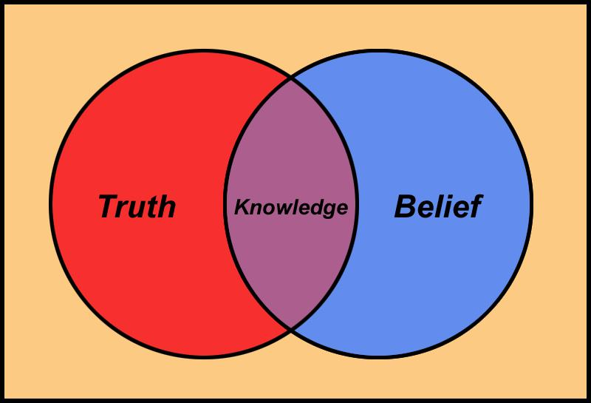
Why do we need to understand ways of knowing? Why do we need to understand how we construct reality?
What are the consequences or implications of what we project or present as reality?
Is evidence important? Why or why not?
How do we interpret? Should we interpret?
Philosophical questions are unavoidable in in knowledge gathering and discovery / invention / innovation. What questions to ask? What methods to use? Why? Can everything be subjected to research? Are there some questions we cannot ask? Some things we cannot know?

Slide 3
Knowing, not knowing, ignorance, knowledge of ignorance
How do we know that we know or not know?
What do we know? The power of concepts
How much do we know?
Aristotle: Episteme, Techne and Phronesis ;
Tacit knowledge; Ability to use knowledge
Does it really matter?

Slide 4
Realism, Representative Realism
Idealism: reality is mentally constructed; cannot know any mind-independent thing
Human ideas (eg. beliefs and values) shape society
Realism: Reality is independent of observation; reality exists independently of observers
Perception / observation as sources of knowledge about the world out there
Representative realism: we cannot ‘see’ or know the external world directly: ideas and interpretations; no first-hand knowledge; know via some means or mechanisms or procedures or tools; use of sense organs and instruments
Einstein-Heisenberg debate
Critical realism: Sense-data do and do not represent external objects accurately: connection between mind-dependent and mind-independent external world
Philosophy of science vis a vis social /human sciences; uncertainty as a problem
Meaningful and non-meaningful questions

Slide 5
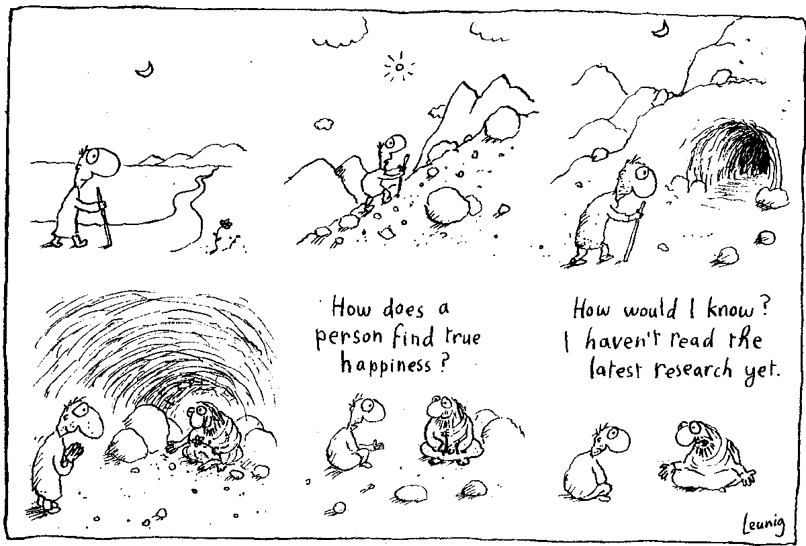
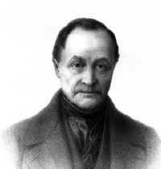
Positivism and Empiricism
Knowledge using sense organs; hard facts; knowledge comes (only) from primary or secondary sensory experience; experience and evidence lead us to knowledge; scientific method and knowledge generation
No role for pure reasoning, revelation, intuition
Knowledge can be of quantitative or qualitative kind
Classification, generalization, prediction

Slide 6
Critique of empiricism
Can facts alone constitute knowledge? How do we make sense of facts? Role of concepts, theories, frameworks, analytical schemes
Can we obtain facts without theories and concepts? Do theories and concepts prejudice us? How do we know where to look, what to observe, how to interpret?
Social Construction / Constructivist Approach:
How and why do we accept or reject knowledge? Laboratory studies (Latour, Woolgar, and Bloor); science as one among many knowledge cultures; funding, methodology, tools and techniques, publication, ideology, networks, personal preferences, everyday practices
Do / should we always go by facts in human endeavour?
Science / Technology and Development

Slide 7
Positivism, Logical Positivism, Empiricism, Quantification
Postulates
postulate of natural kinds: all instances of classes and categories of phenomena exhibit the same properties
postulate of constancy: all phenomena remain the same or change only very slowly over time
postulate of determinism: there is orderliness and regularity in nature, constancy in terms of cause and effect
Advantages and disadvantages
What can and cannot be measured; what is evidence
Critique of positivism
Evidence, Interpretation, analysis, context, wholism
False dualisms
truth and non-truth, cause-effect, fact-interpretation, facts-theory

Slide 8
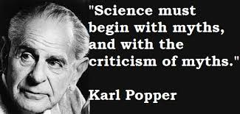
Post-positivism, critical realism, critical sciences
Little difference between how scholars / academics think and how common people think; difference of degree, not kind; similar processes in scientific and common sense reasoning; in indigenous knowledge and science.
Importance of multiple measures and tools, triangulation, openness to methods and techniques
Karl Popper
Induction and Deduction
Verification vs Empirical Falsification
Conjectures and Refutations
Critical Rationalism: levels of probability, information content, and preferred knowledge – good reasons, corraboration not acceptable
Science vs Non-science / pseudo-science

Slide 9
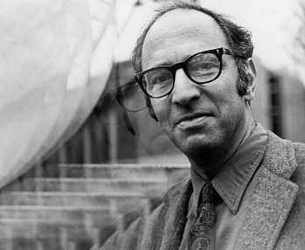
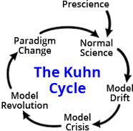
Thomas Kuhn
Structure of Scientific Revolutions: “progress” in science, new discoveries and knowledge growth
Paradigms, Paradigm shifts, and Scientific Revolution
Objectivity and Subjectivity
Pre-science, normal science, revolutionary science
Incommensurability
Theory Choice:
Accurate
Consistent
Broad Scope
Simple
Fruitful

Slide 10
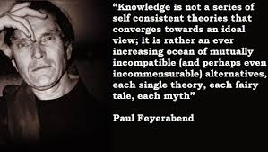
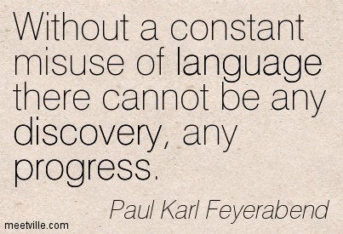
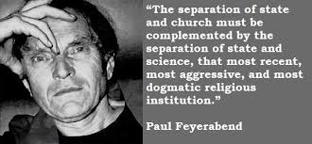
Paul Feyerabend: Against Method
Methodological pluralism / individualism
No universal methodological rules?
Methods, Scientific Activity, and Scientific Progress
Theoretical anarchism and humanitarianism / freedom
Critique of consistency criterion and falsificationism

Slide 11
Values
Facts and values: what is and what ought to be?
Gunnar Myrdal: Acknowledge Values explicitly
What is a fact?
Impossibility of value free / neutral research? Role of Ideology?
Weber: Verstehen (Empathy, sympathetic understanding); intuitive interpretation; multiculturalism and interpretation; gender and interpretation‏

Slide 12
Process of observing, selecting and naming phenomena is a normative act: reflects social and ethical norms
Empiricism / positivism: do they guarantee objectivity?
Why do we need to be scientific? Do we need to be scientific?
What is meant by science?
Why do we need to be concerned about methodological issues?
What are the implications for thinking about development?
Is science and technology what scientists and technologists do?
Do only scientists and technologists do science and technology?

Slide 13
Tracing Science-Technology-Development linkages historically
Geographical differences: does it matter? Historical evolution and lag?
Can it be explained in cultural terms?
Ideas of development and the future: role for science and technology
Universal visions?
Import/Transfer, Copy/Imitate, Adapt/Innovate, Invent/Re-invent
Importance of context for shared and dis-similar goals and visions

Slide 14
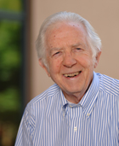
Technological trajectories: how to explain?
Nathan Rosenberg: Inside the Black Box
Evolution, Economy, Endogeneity in technological growth
Technological, and Economic/Social/Political Feasibility
Short and Long term consequences; immediate and larger implications – revolutionize knowledge, production, thinking, social and economic structures and processes
Technological change across sectors: institutions, skills, strategies are different
Path dependence of technological change: history of the economy, but also of cultures of innovation and sicovery

